Slide 1
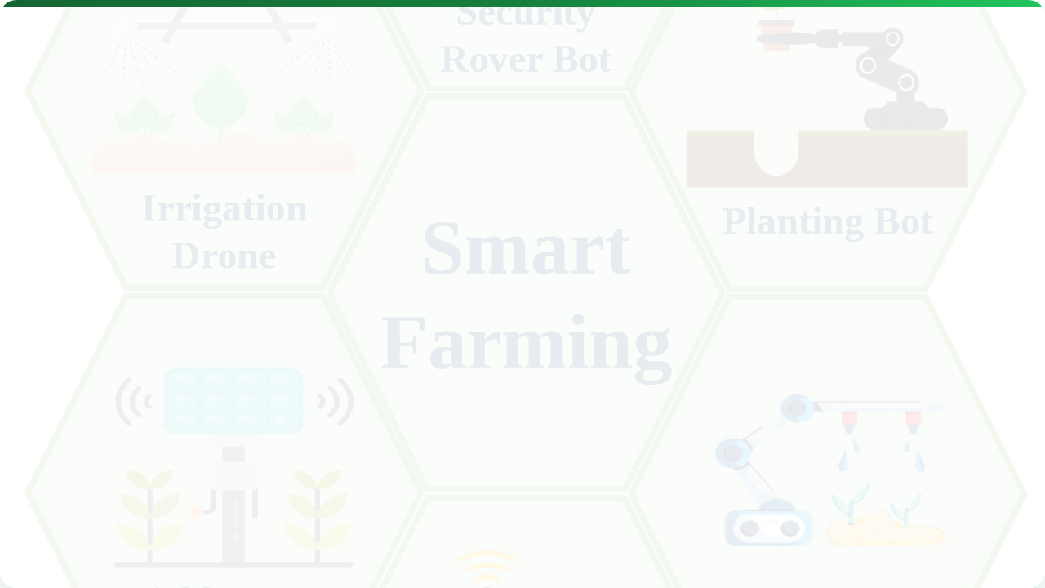



DATA MANAGEMENT & ANALYSIS
Lecture 10: Turning Data into Decisions
AGE 418
Dr. Kadeghe Fue

Slide 2




Lecture Roadmap
Management
Analysis
The Data Lifecycle
Spatial Interpolation
Storage (Cloud vs Local)
FMIS Software
File Formats (Shapefiles)
Data Privacy & Ownership
Cleaning & Quality

Slide 3
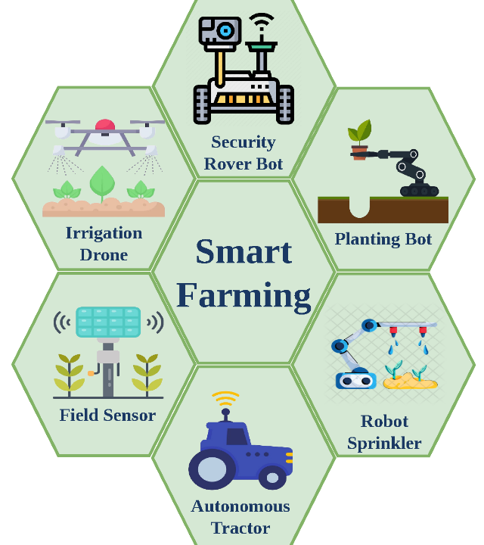
Data is the New Oil
In Precision Agriculture, data is a farm asset, just like land or machinery.
However, raw data is useless. It must be Refined (Processed) to become valuable Information.

Slide 4







The Data Lifecycle
1. Collect
2. Clean
3. Analyze
4. Act
Sensors, Yield Monitors, Drones.
Remove errors, outliers, and bad GPS fixes.
Interpolation, Correlation, Zoning.
Prescription Maps, Management decisions.

Slide 5
Storage: Local vs Cloud
Local (USB/Desktop)
Cloud (Wireless)
Physical transfer from tractor to office.
Automatic sync via GSM/WiFi.
Pro: Secure, works offline.
Pro: Instant access, backups, shareable with agronomist.
Con: "Sneakernet" (walking USBs around), risk of drive failure.
Con: Requires internet, subscription fees.

Slide 6
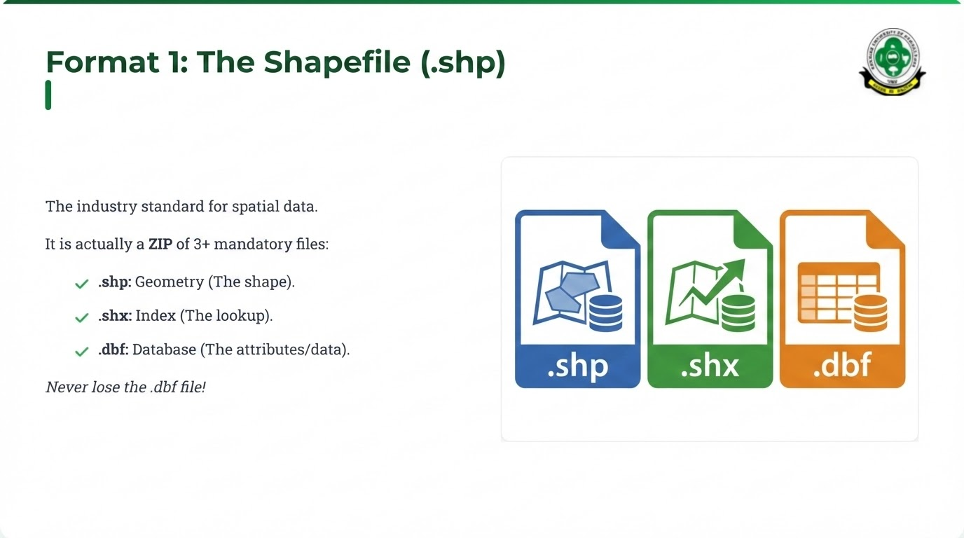

Slide 7

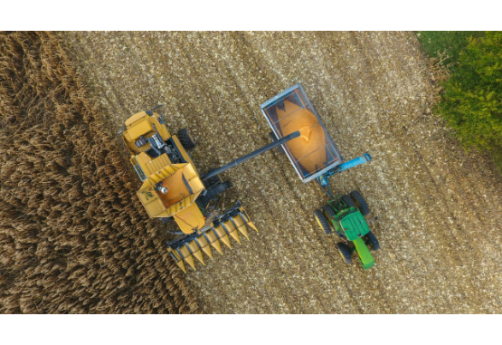
Format 2: ISOXML
The Modern Standard (ISO 11783).
Designed specifically for agriculture to ensure plug-and-play between brands (John Deere, Case IH, New Holland).
Includes Task Data (Who, What, Where).
Supports Variable Rate maps natively.

Slide 8
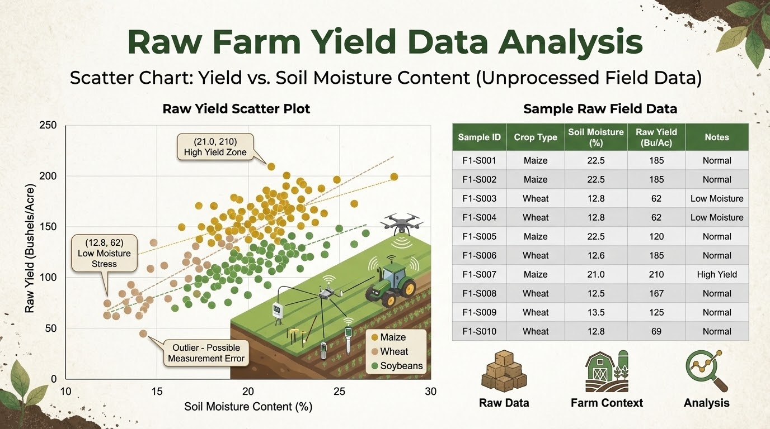
Data Cleaning
"Garbage In, Garbage Out"
Up to 30% of raw yield data is erroneous.
Flow Delay: Grain travel time not accounted for.
Start/Stop: Ramping up speed at edges.
Outliers: Impossible values (e.g., 20 tons/ha for Maize).

Slide 9



Spatial Analysis
Moving from Points to Surfaces.
Soil samples are discrete points. To make a VRA map, we need to estimate the values between the points. This is called Interpolation.

Slide 10

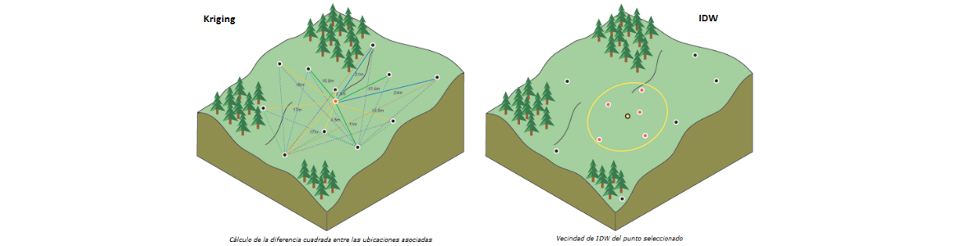
Interpolation Methods
IDW
Kriging
Inverse Distance Weighting.
Geostatistical.
Simple. Things closer are more related than things further away. Best for dense data (Yield Maps).
Complex. Uses statistical probability (Semivariogram) to predict values. Best for sparse data (Soil Samples).

Slide 11
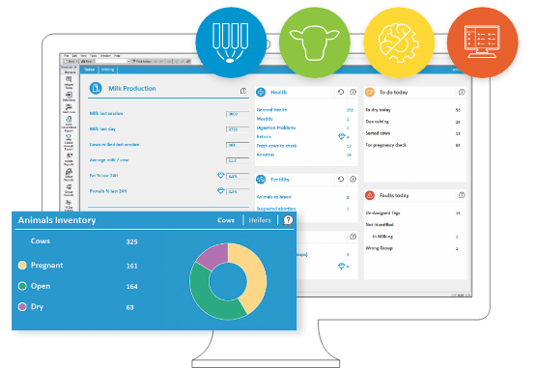
FMIS: Farm Management Information Systems
The software hub where all data meets.
Functions: Record keeping, Map creation, Profit analysis, VRA prescription writing.
Examples: SMS Advanced, John Deere Ops Center, Trimble Ag Software.

Slide 12

The Problem of Interoperability
"The Tower of Babel"
Farmers often have mixed fleets (e.g., Red Tractor, Green Combine, Blue Sprayer).
Proprietary
APIs
AgGateway
Brands locking data to their own format.
Software "bridges" that allow clouds to talk.
Industry consortium fighting for standards (ADAPT framework).

Slide 13
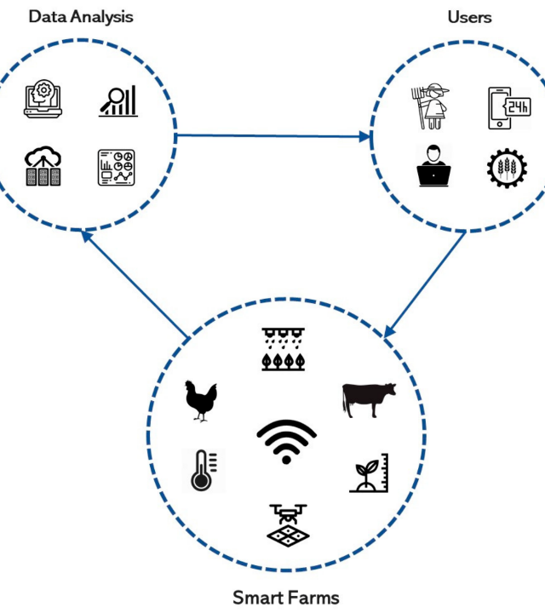
Data Privacy & Security
Who owns the data?
The Farmer? (It's their land).
The Manufacturer? (Their sensors collected it).
The Service Provider? (They processed it).
Big Question: Can aggregators use my data to trade against me in the commodities market?

Slide 14

Future: Big Data & AI
Moving from Descriptive ("What happened?") to Prescriptive ("What should I do?").
Benchmarking: Compare your field to 1,000 anonymized neighbors.
AI Models: Predicting pest outbreaks before they happen based on weather patterns.

Slide 15
Lecture Summary
Management
Analysis
Ethics
Clean data is crucial. Cloud storage is enabling easier access.
Interpolation (Kriging/IDW) turns points into maps.
Ownership and privacy remain critical challenges in the digital age.

Slide 16
Assignment
Manungu, Turiani Farms
Analysis
Insights
Map all Sugar Cane farms at Mtibwa Sugar for Season 2024/2025
Determine the NDVI for Each Farm using Sentinel Satellite
Discuss possible issues on NDVI differences
Next Class: Lecture 11 - DSS & AI

Slide 17

Questions?
Dr. Kadeghe Fue | AGE 418
Sokoine University of Agriculture

